Slide 1
Lending Club Case Study
Ganesh Kumar

Slide 2
Objective
Study EDA technique on a real world problem and understand the insights. Minimise risk of loans by statistically analysing past data and figuring out patterns which could be used to avoid certain loans.

Slide 3
Univariate Analysis Conclusion
People are more likely to default when :
Interest rate is between 15-20 %.
Funds are in range 10-15k.
Installment value in range 200-400.
DTI is between 10-15
Annual income in range 30-60k
They are in grade B and specifically riskier is subgrade in F5
loan term is 36 months
They are paying rent
They have been working for 10 or more years
source of funds not verified
when the purpose is debt consolidation
loan is issued in month of december

Slide 4
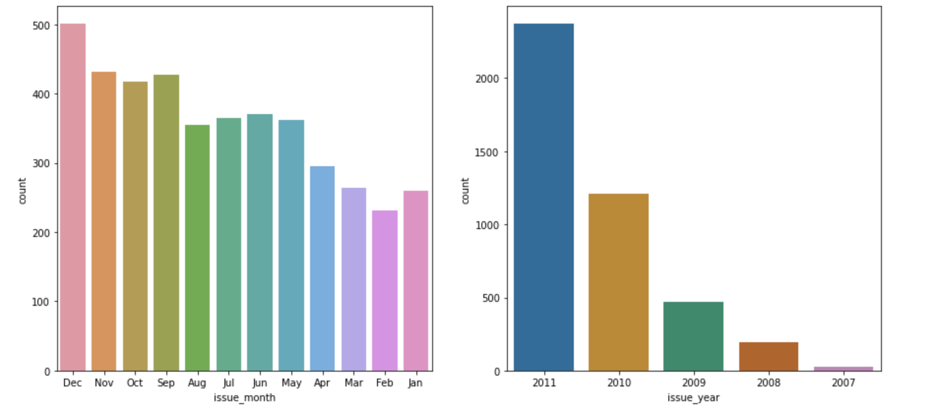
Defaulters against issue month and issue year

Slide 5
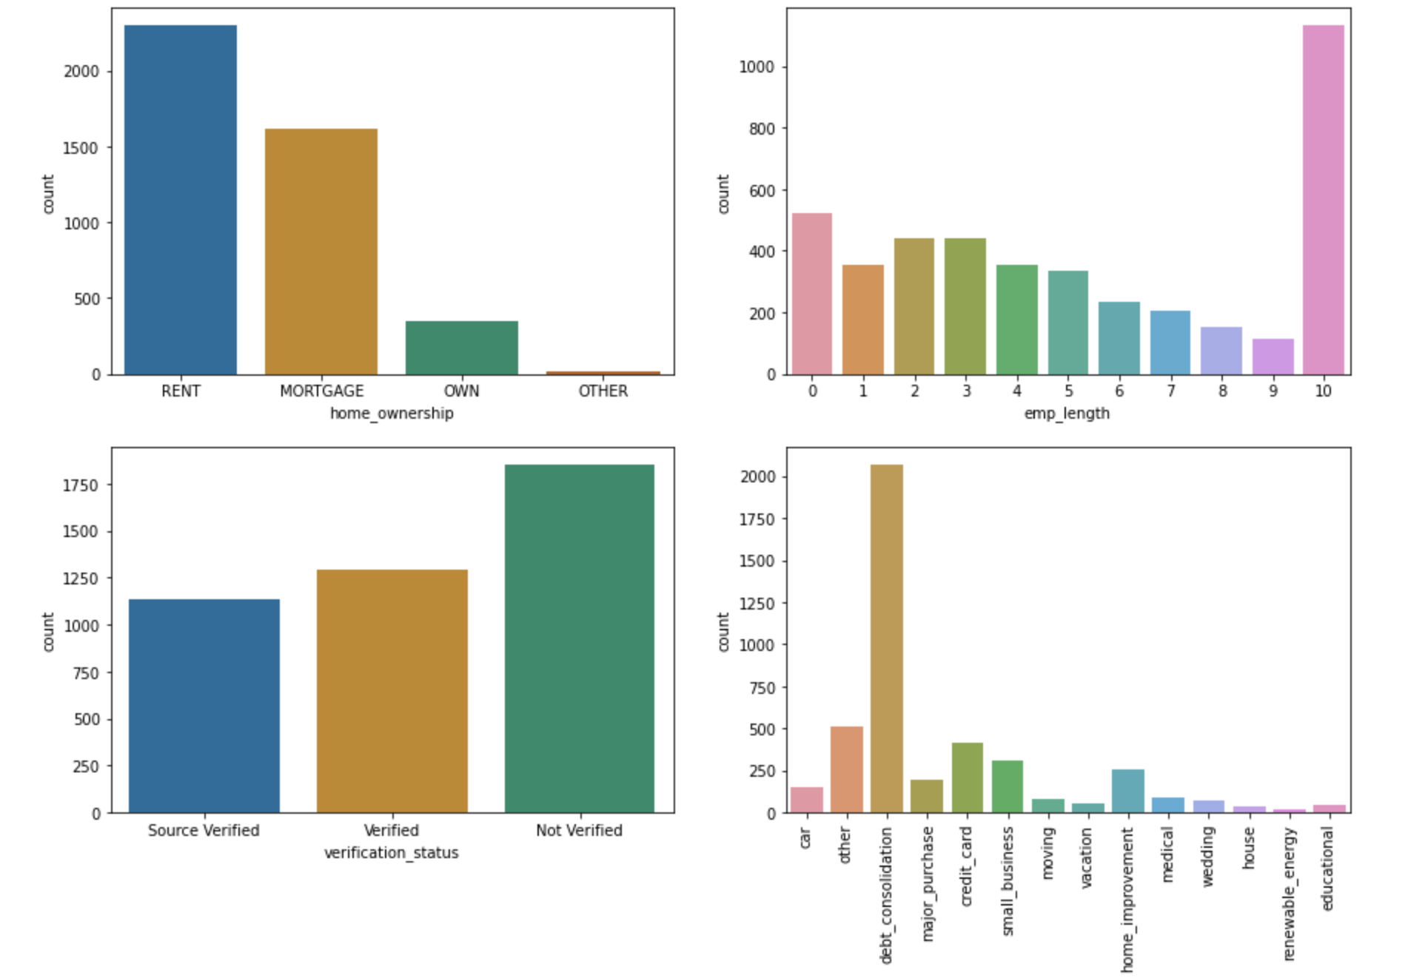
Defaulters against home ownership, job duration, income verification and purpose

Slide 6
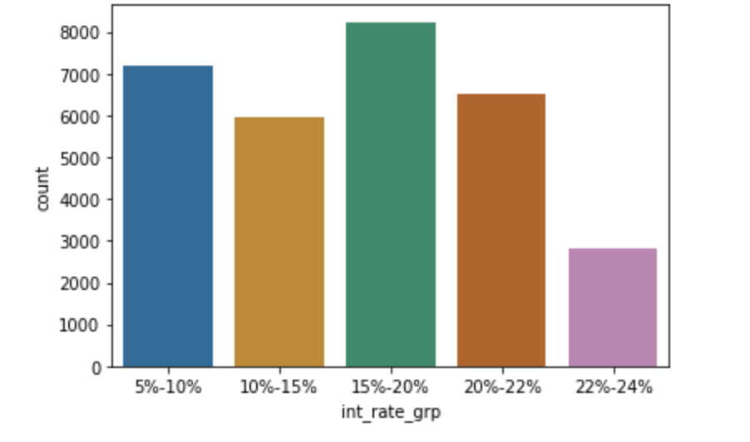
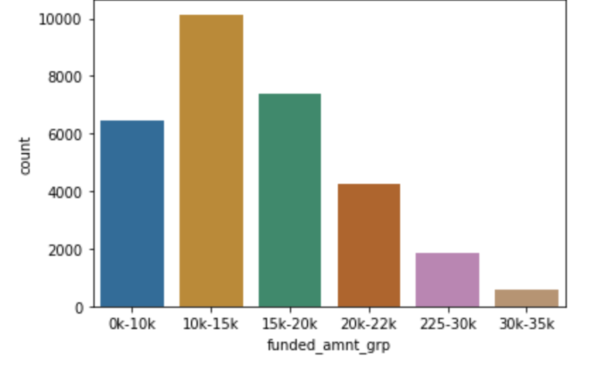
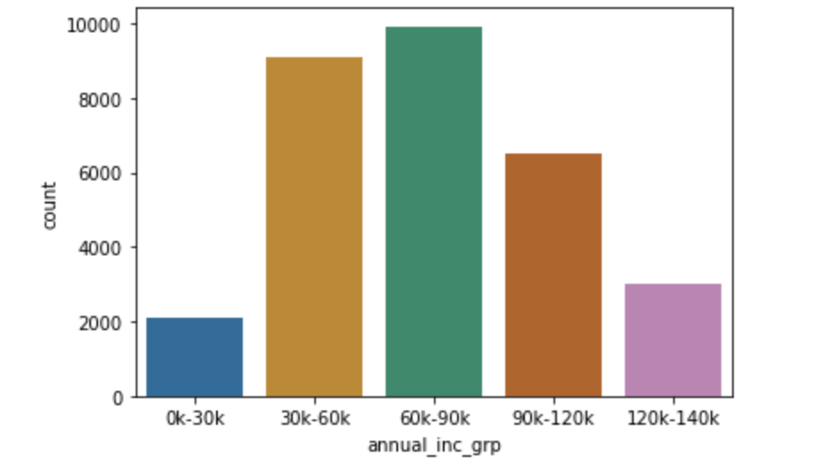
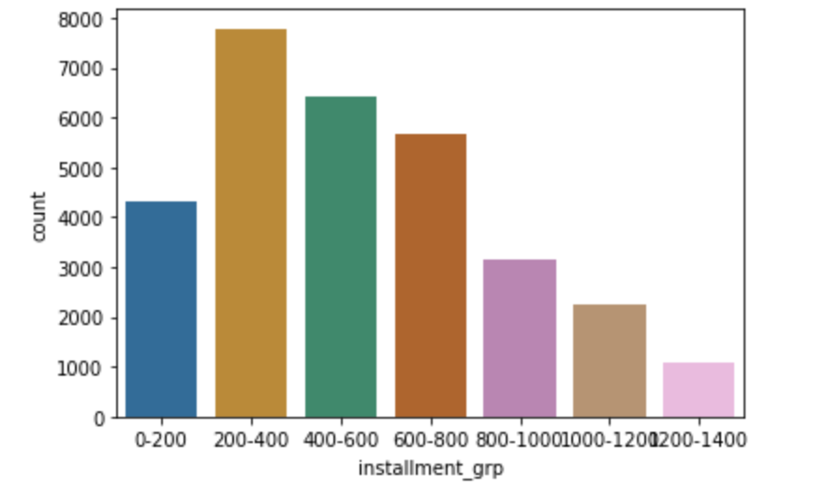
Defaulters against interest rate, fund amount, annual income and installment size

Slide 7
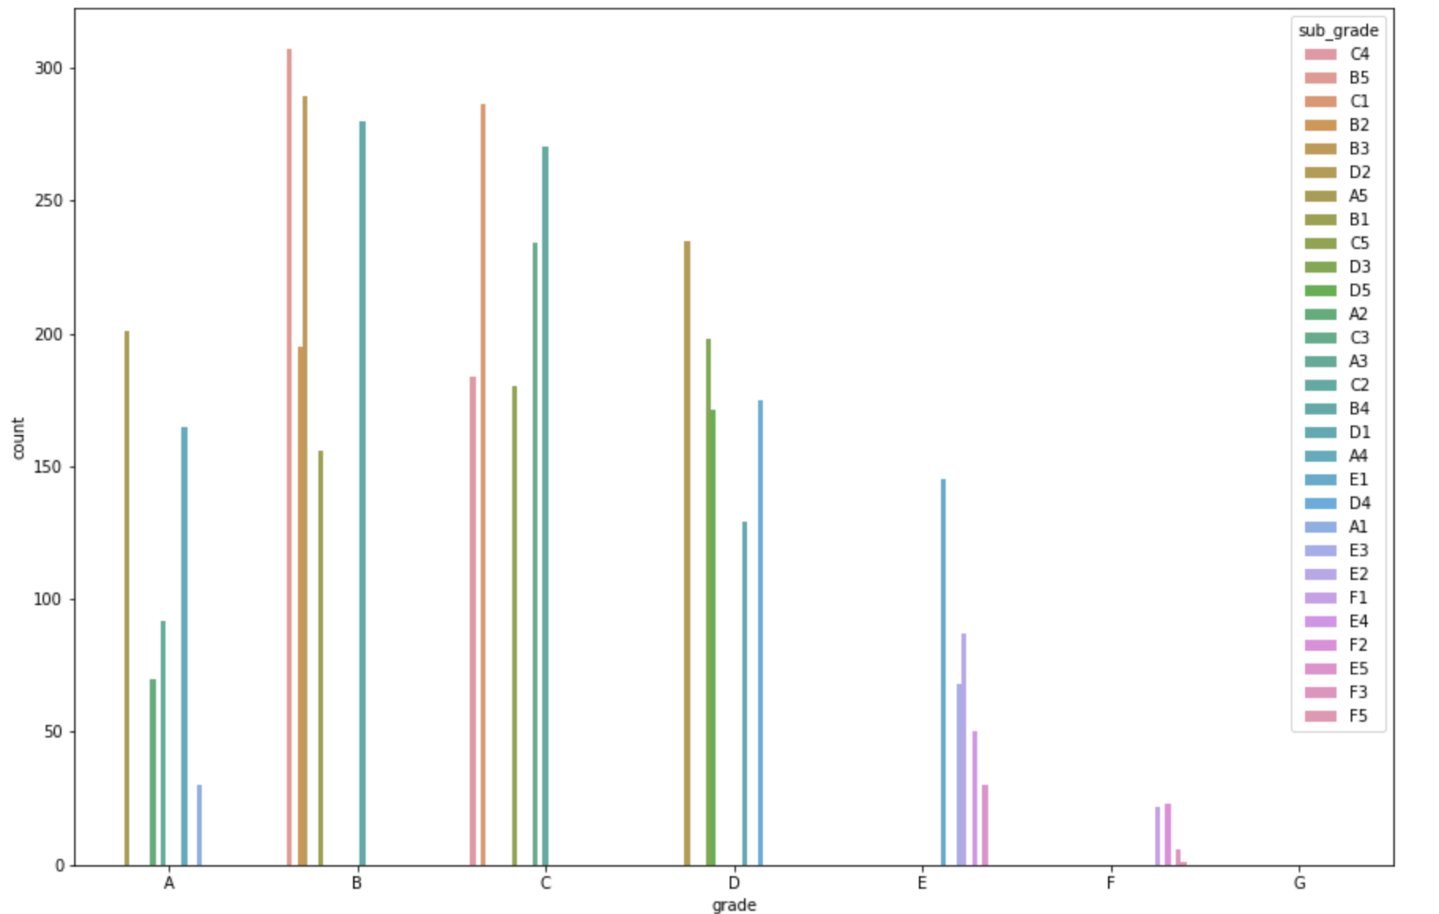
Defaulters against Grades and subgrades

Slide 8
MultiVariate Analysis conclusion
Highest defaulters are in debt_consolation but the annual income of those is second highest.
Top 3 sets of highest earning individuals spent on house_improvement, house and credit_cards in the same order.
higher number of people are defaulting in all Fund_amount groups

Slide 9
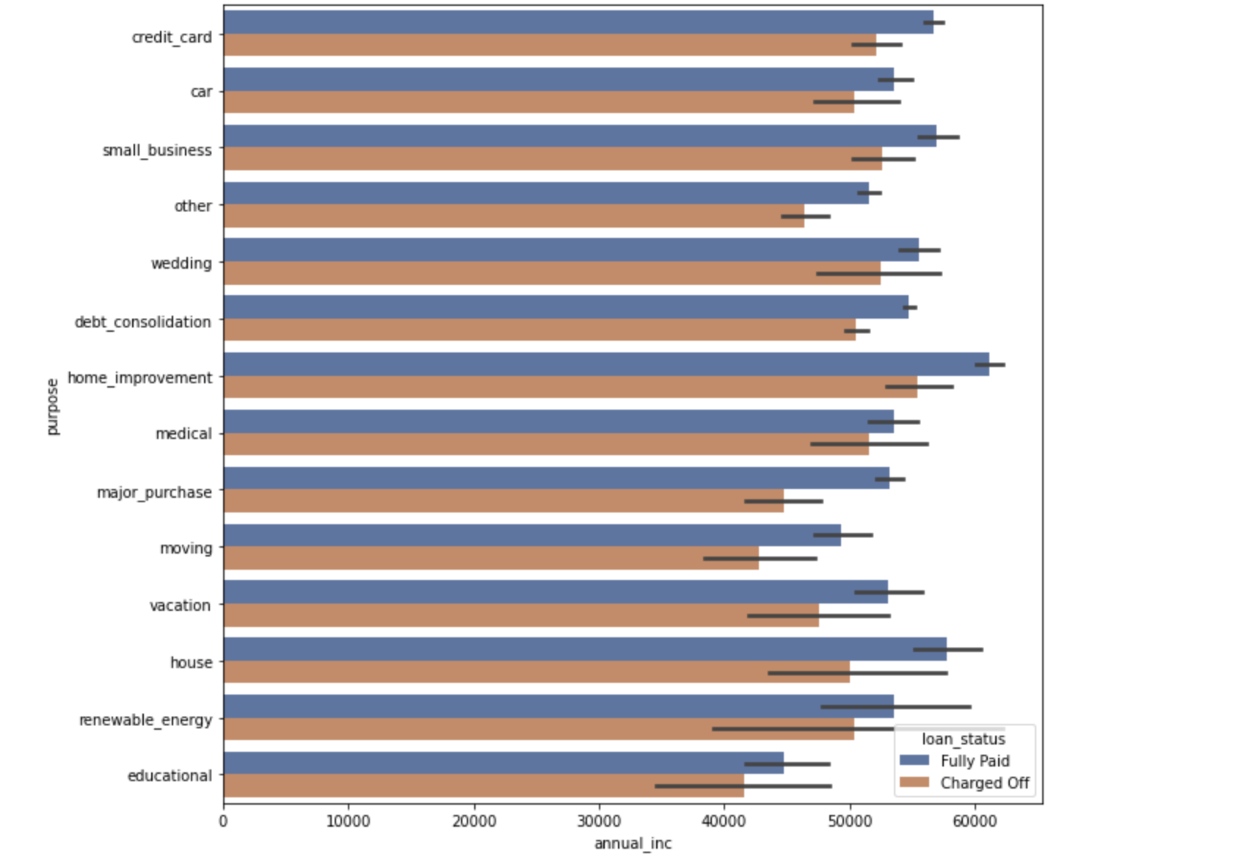
Annual income vs loan purpose

Slide 10
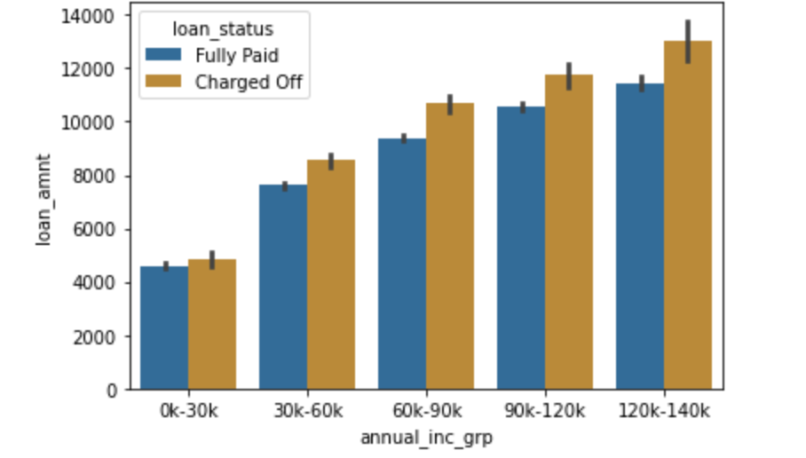
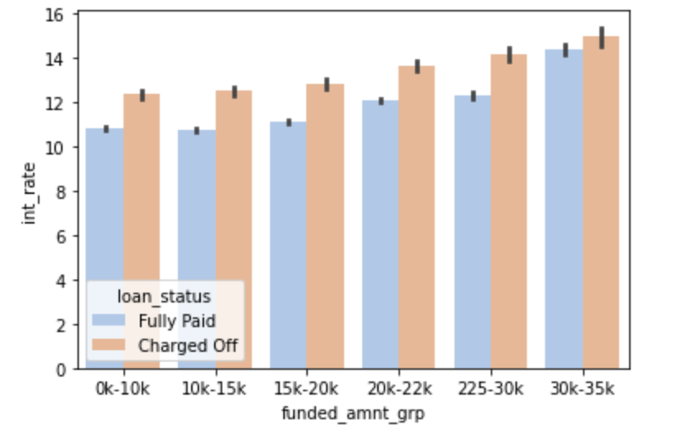
“Annual Income vs Loan amount” And “ Funded Amount vs Interest Rate

Slide 11
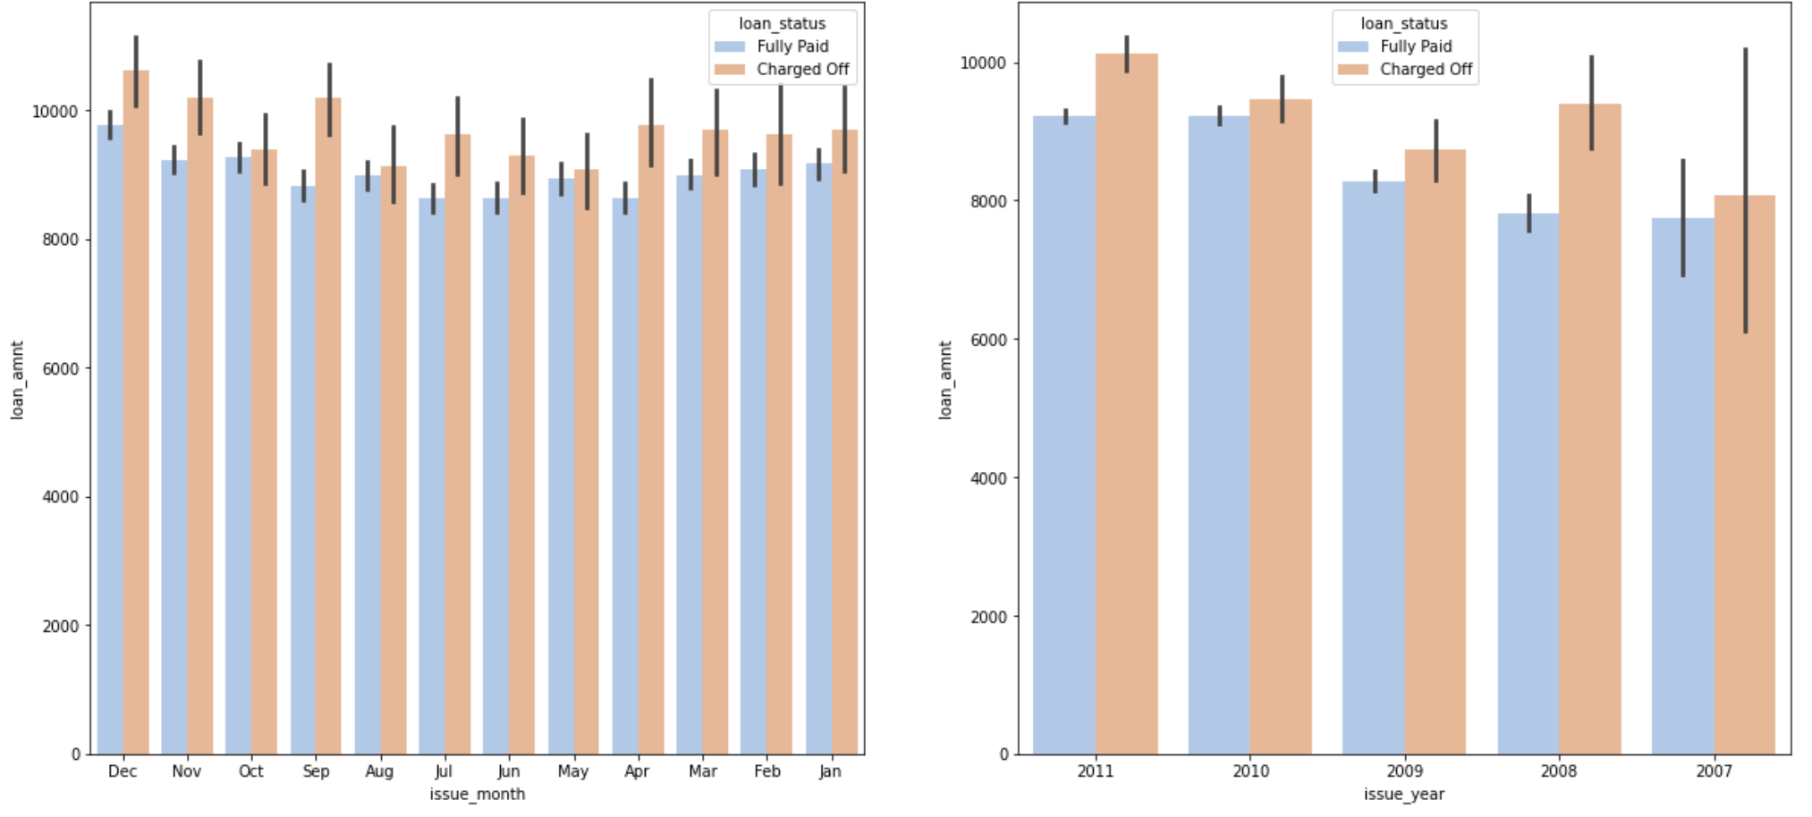
Loan amount vs month issued and year issued

